Slide 1

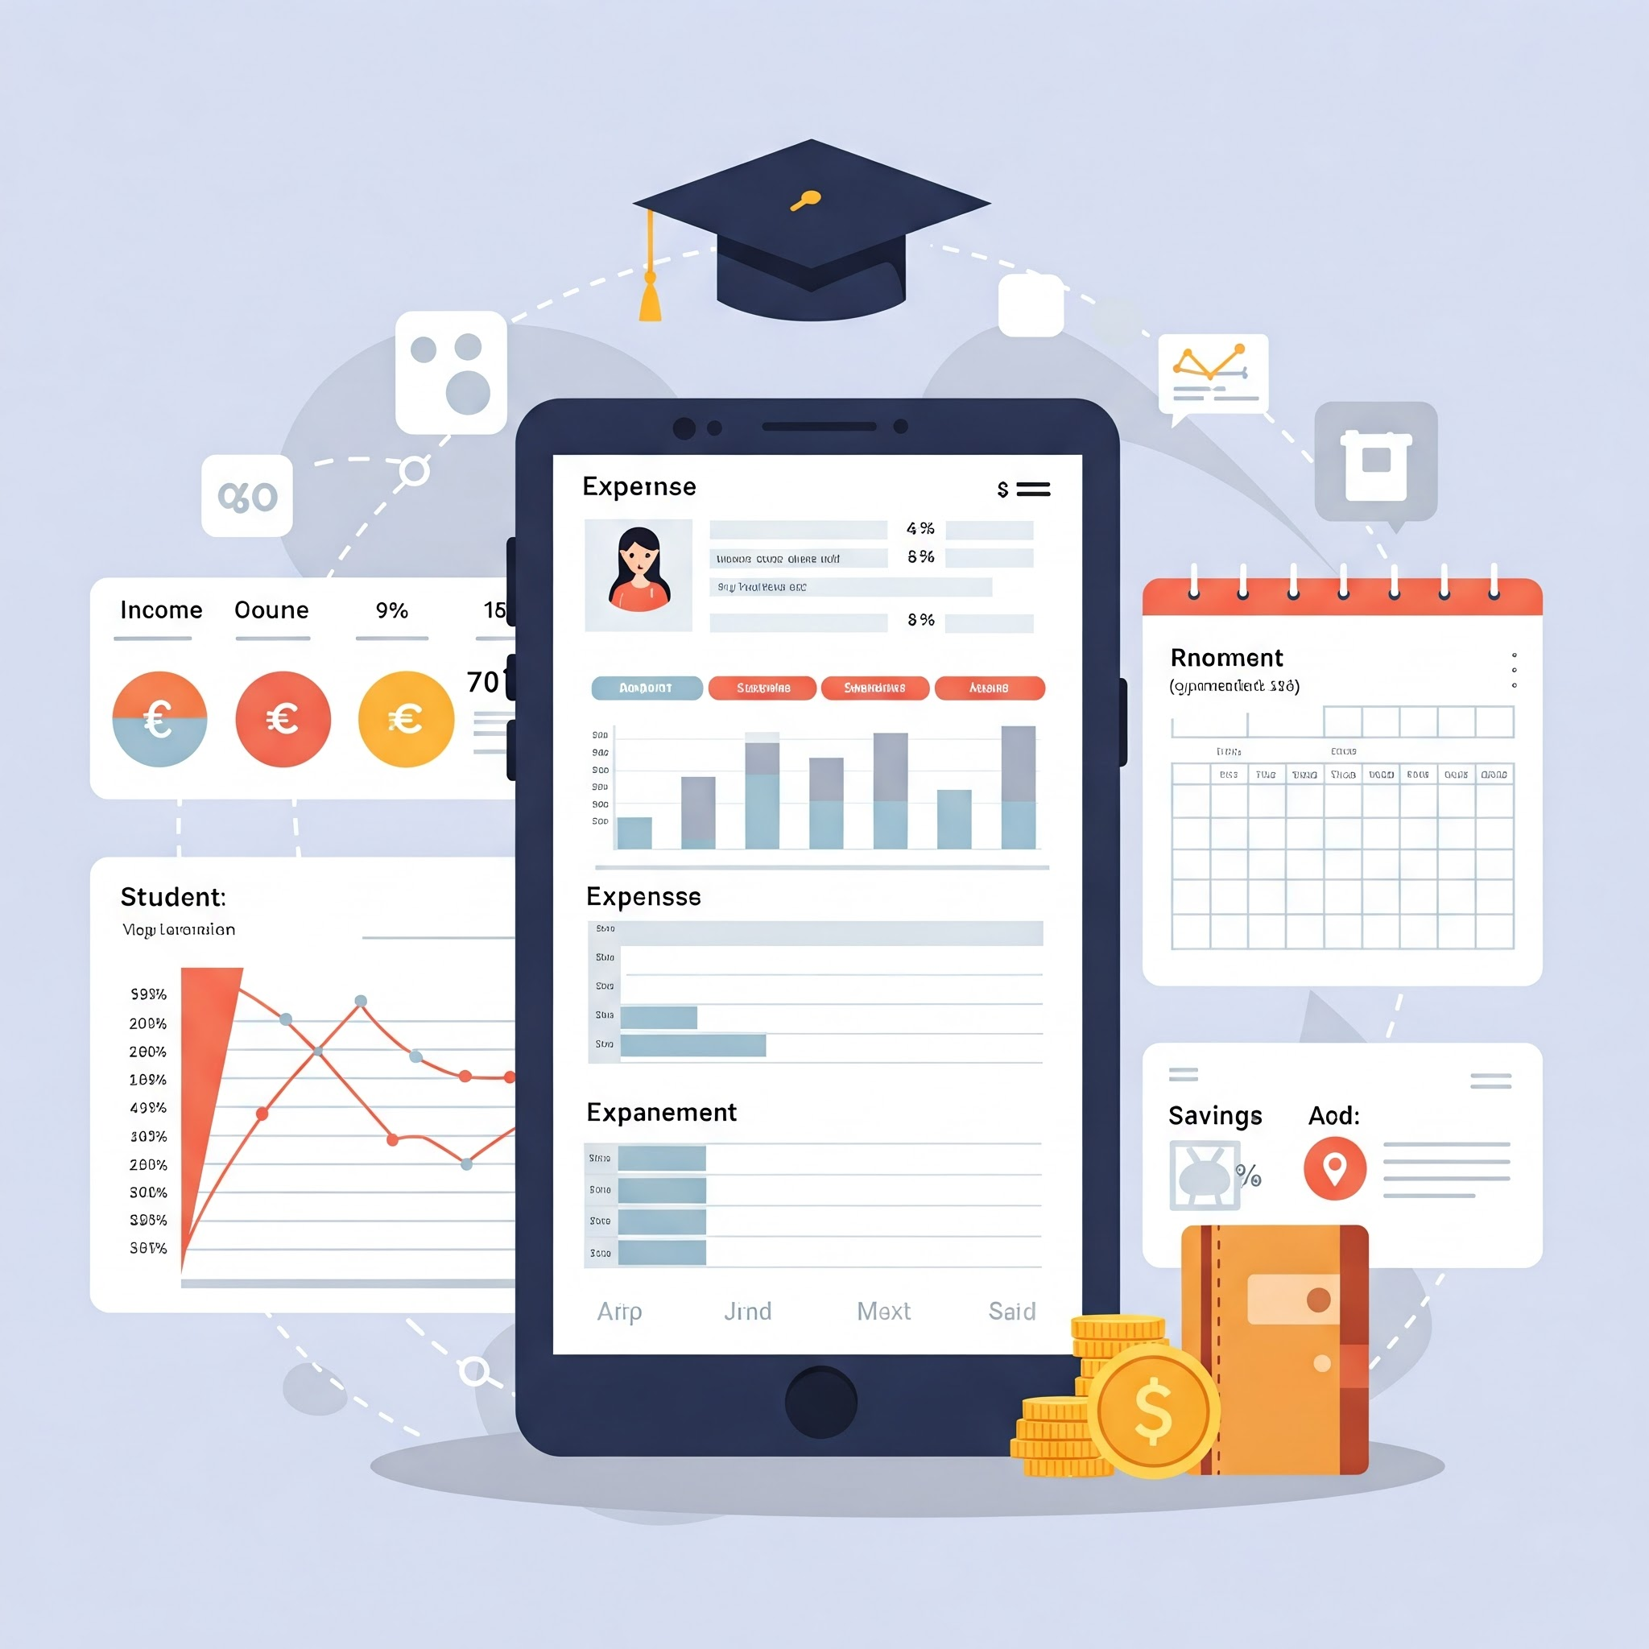

Empowering Student Finances: A Digital Expense Tracker
BY:
Aditya-2401010134
Suhani-2401010176
Prince-2401010253
Alwyn-2401010181
Under Supervision of:
Ms. Suman
K.R. MANGALAM UNIVERSITY

Slide 2

The Problem: Unmanaged Student Finances
The Challenge
Our Solution
Students often lack financial literacy and struggle to manage their limited budgets, leading to overspending and financial distress.
We aim to develop a user-friendly, mobile expense tracker to help students gain control of their finances and build positive financial habits.
K.R. MANGALAM UNIVERSITY

Slide 3
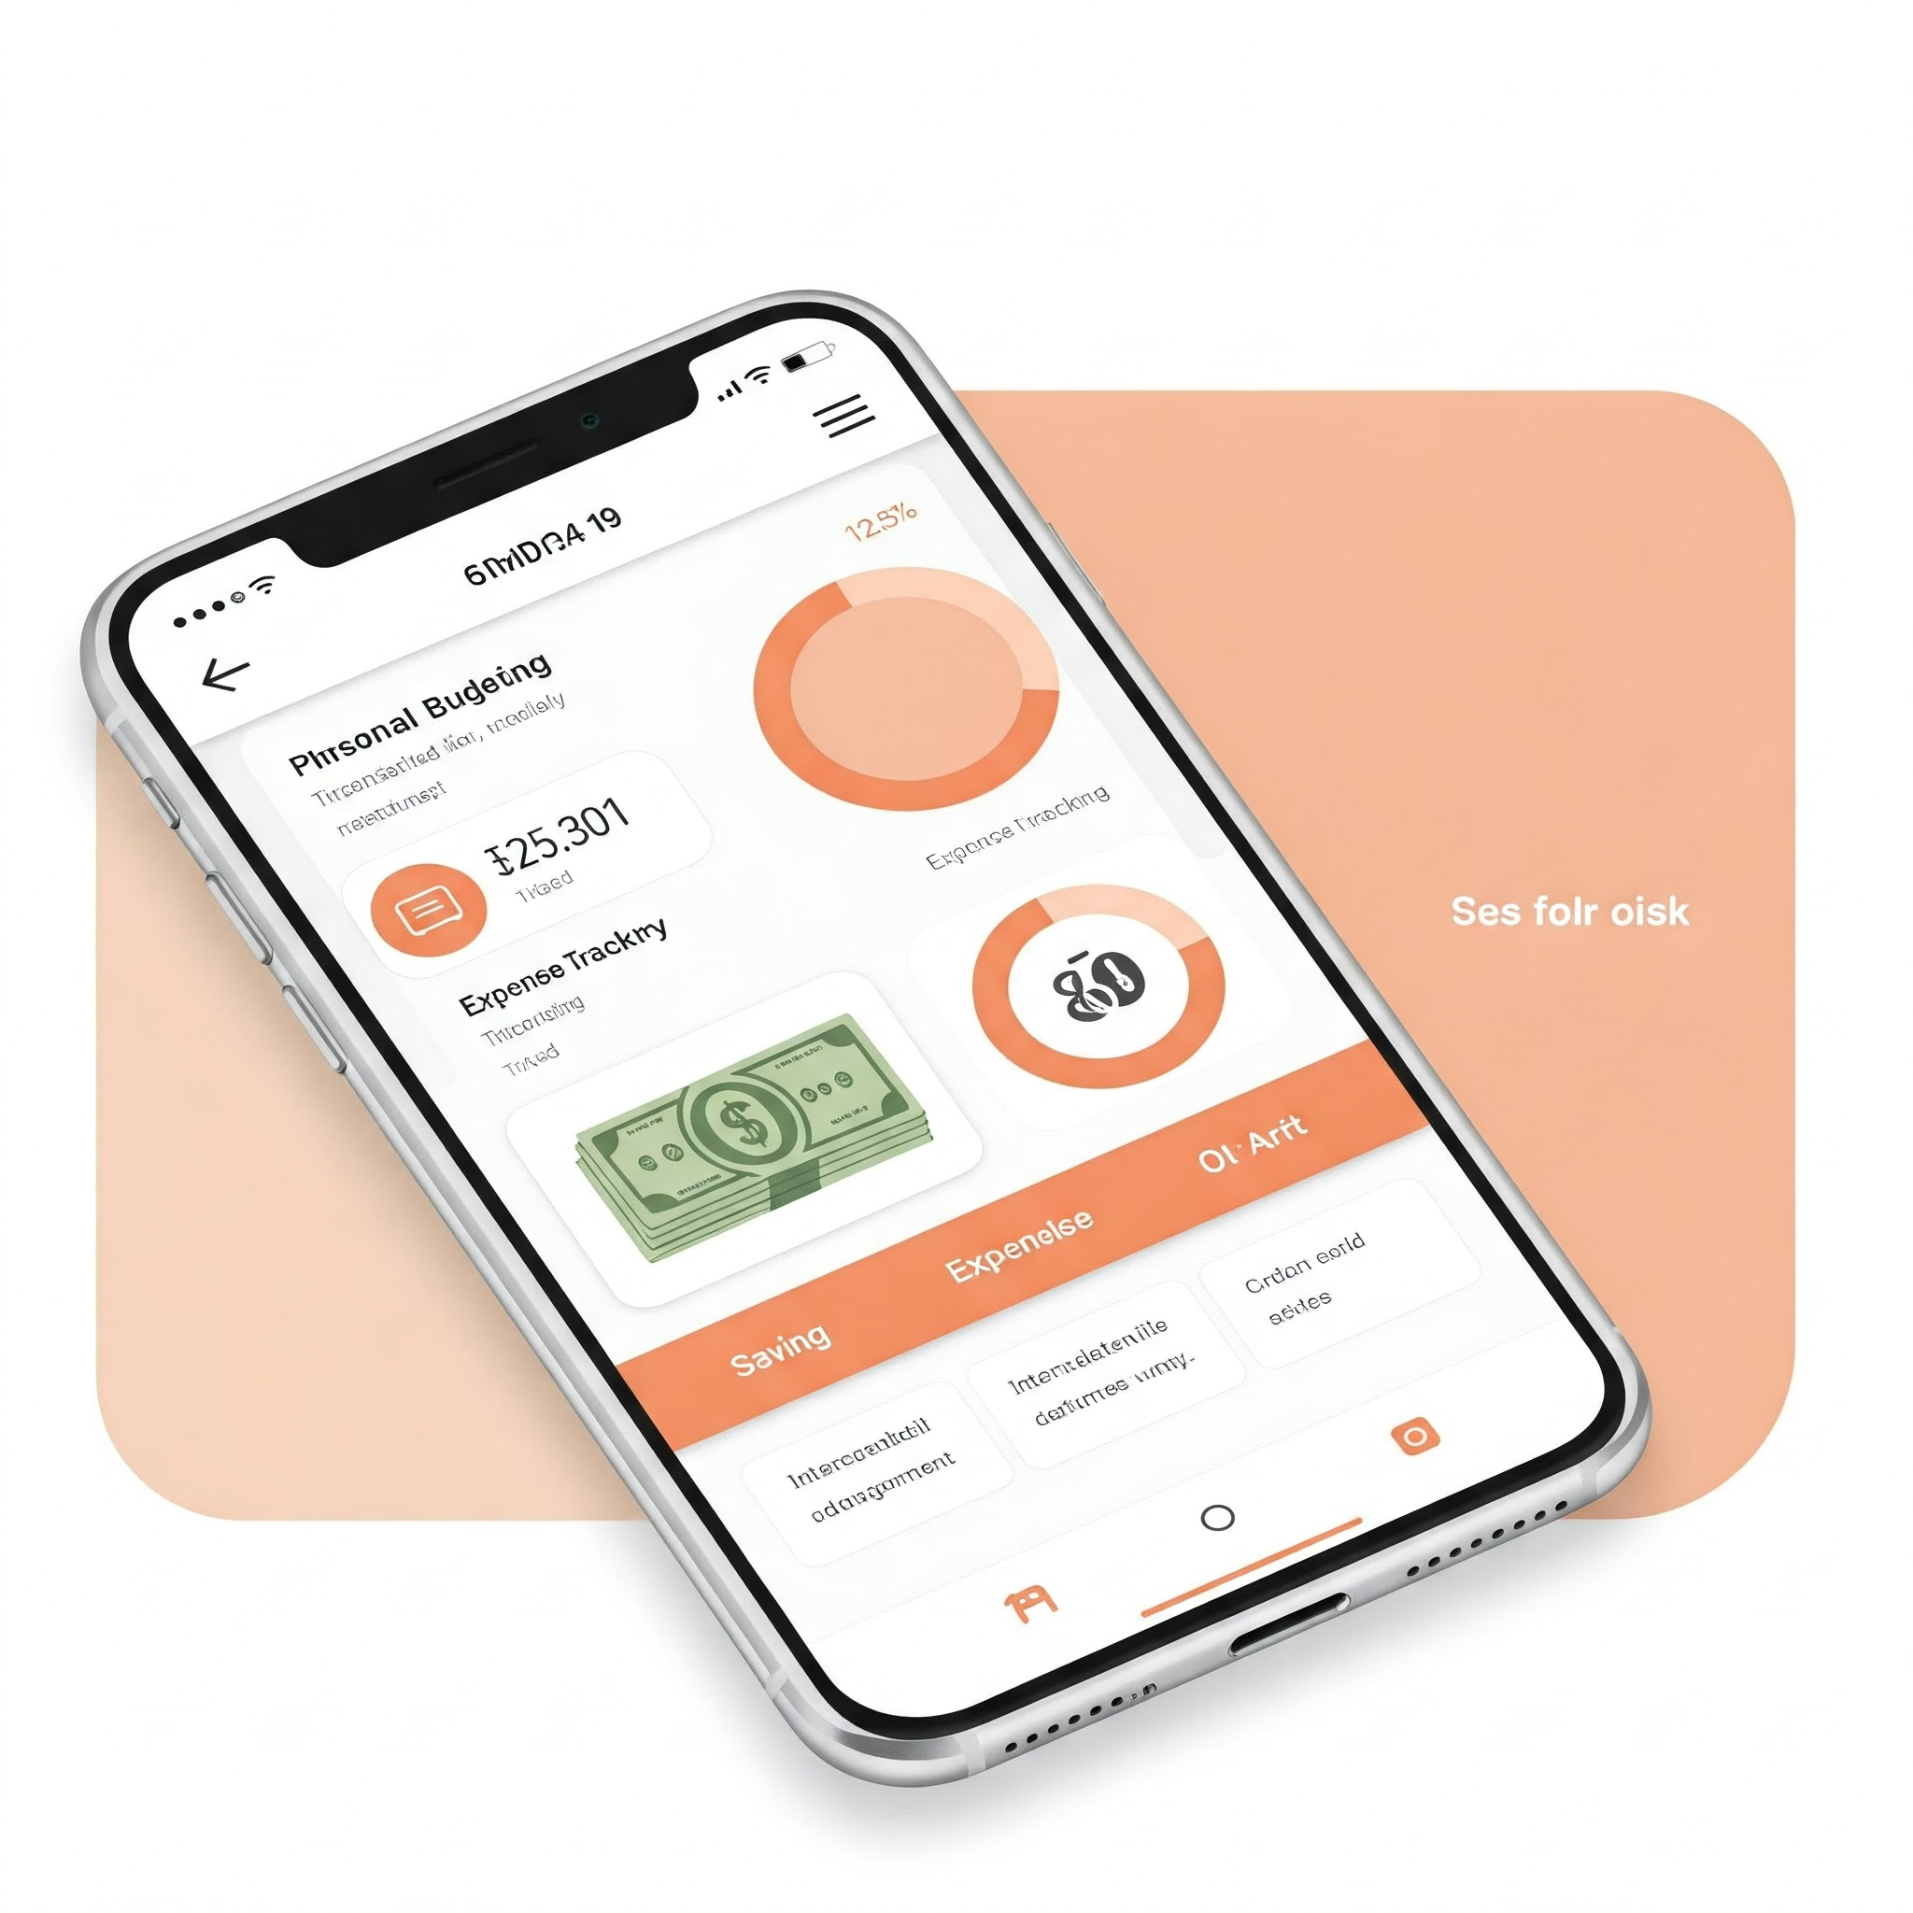
Objectives: Enabling Financial Empowerment
Easy-to-use
Comprehensive Tracking
Our app will feature a simple interface, making it accessible and engaging for students of all backgrounds.
Students can track expenses, set budgets, and analyze spending patterns to make informed financial decisions.
Financial Literacy
The app promotes financial literacy by offering insights into budgeting, saving, and smart spending.
K.R. MANGALAM UNIVERSITY

Slide 4
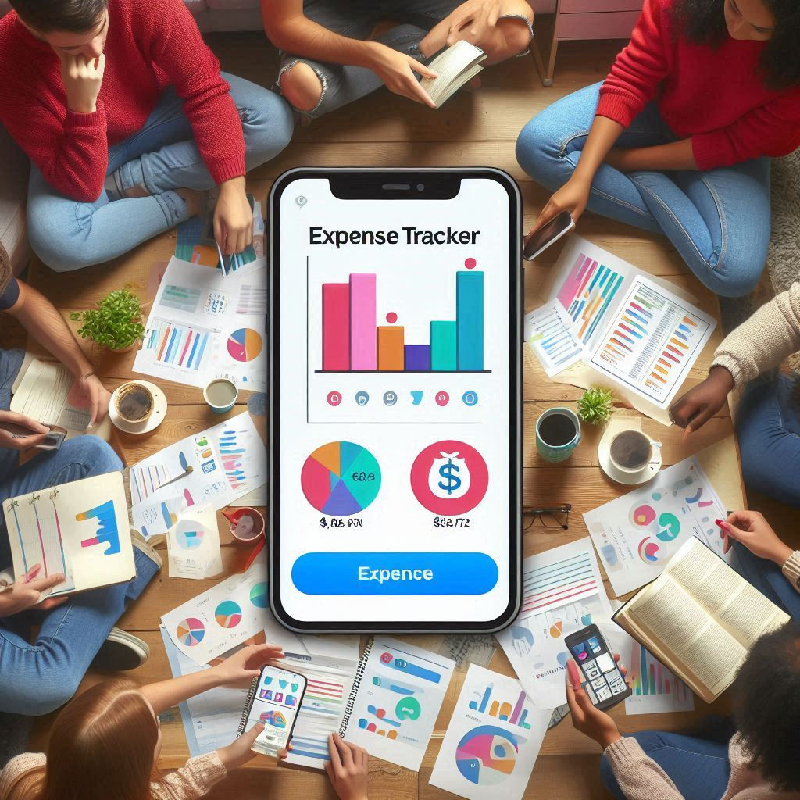
Development Approach: User-Centered Design
1
User Feedback
We will gather data and feedback from students to ensure the app meets their specific needs and preferences.
2
Design and Development
We will design wireframes, create a user-friendly UI/UX, and develop the app for both Android and iOS platforms.
3
Testing and Deployment
The app will undergo rigorous testing to ensure its functionality, usability, and security. It will be deployed on major app stores for widespread accessibility.
K.R. MANGALAM UNIVERSITY

Slide 5
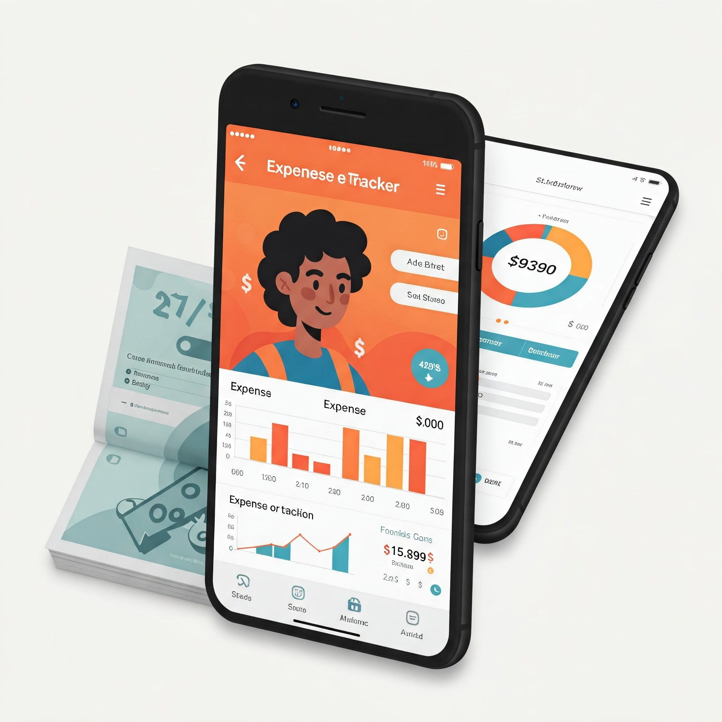
Expected Outcomes: A Transformative Impact
Improved Financial Awareness
Enhanced Budgeting Practices
Students will gain a deeper understanding of their spending habits and learn to manage their money effectively.
The app will empower students to create and monitor budgets, promoting responsible spending and long-term financial stability.
Positive Behavioral Change
We expect the app to foster positive financial behaviors, leading to less debt and improved financial well-being.
K.R. MANGALAM UNIVERSITY

Slide 6
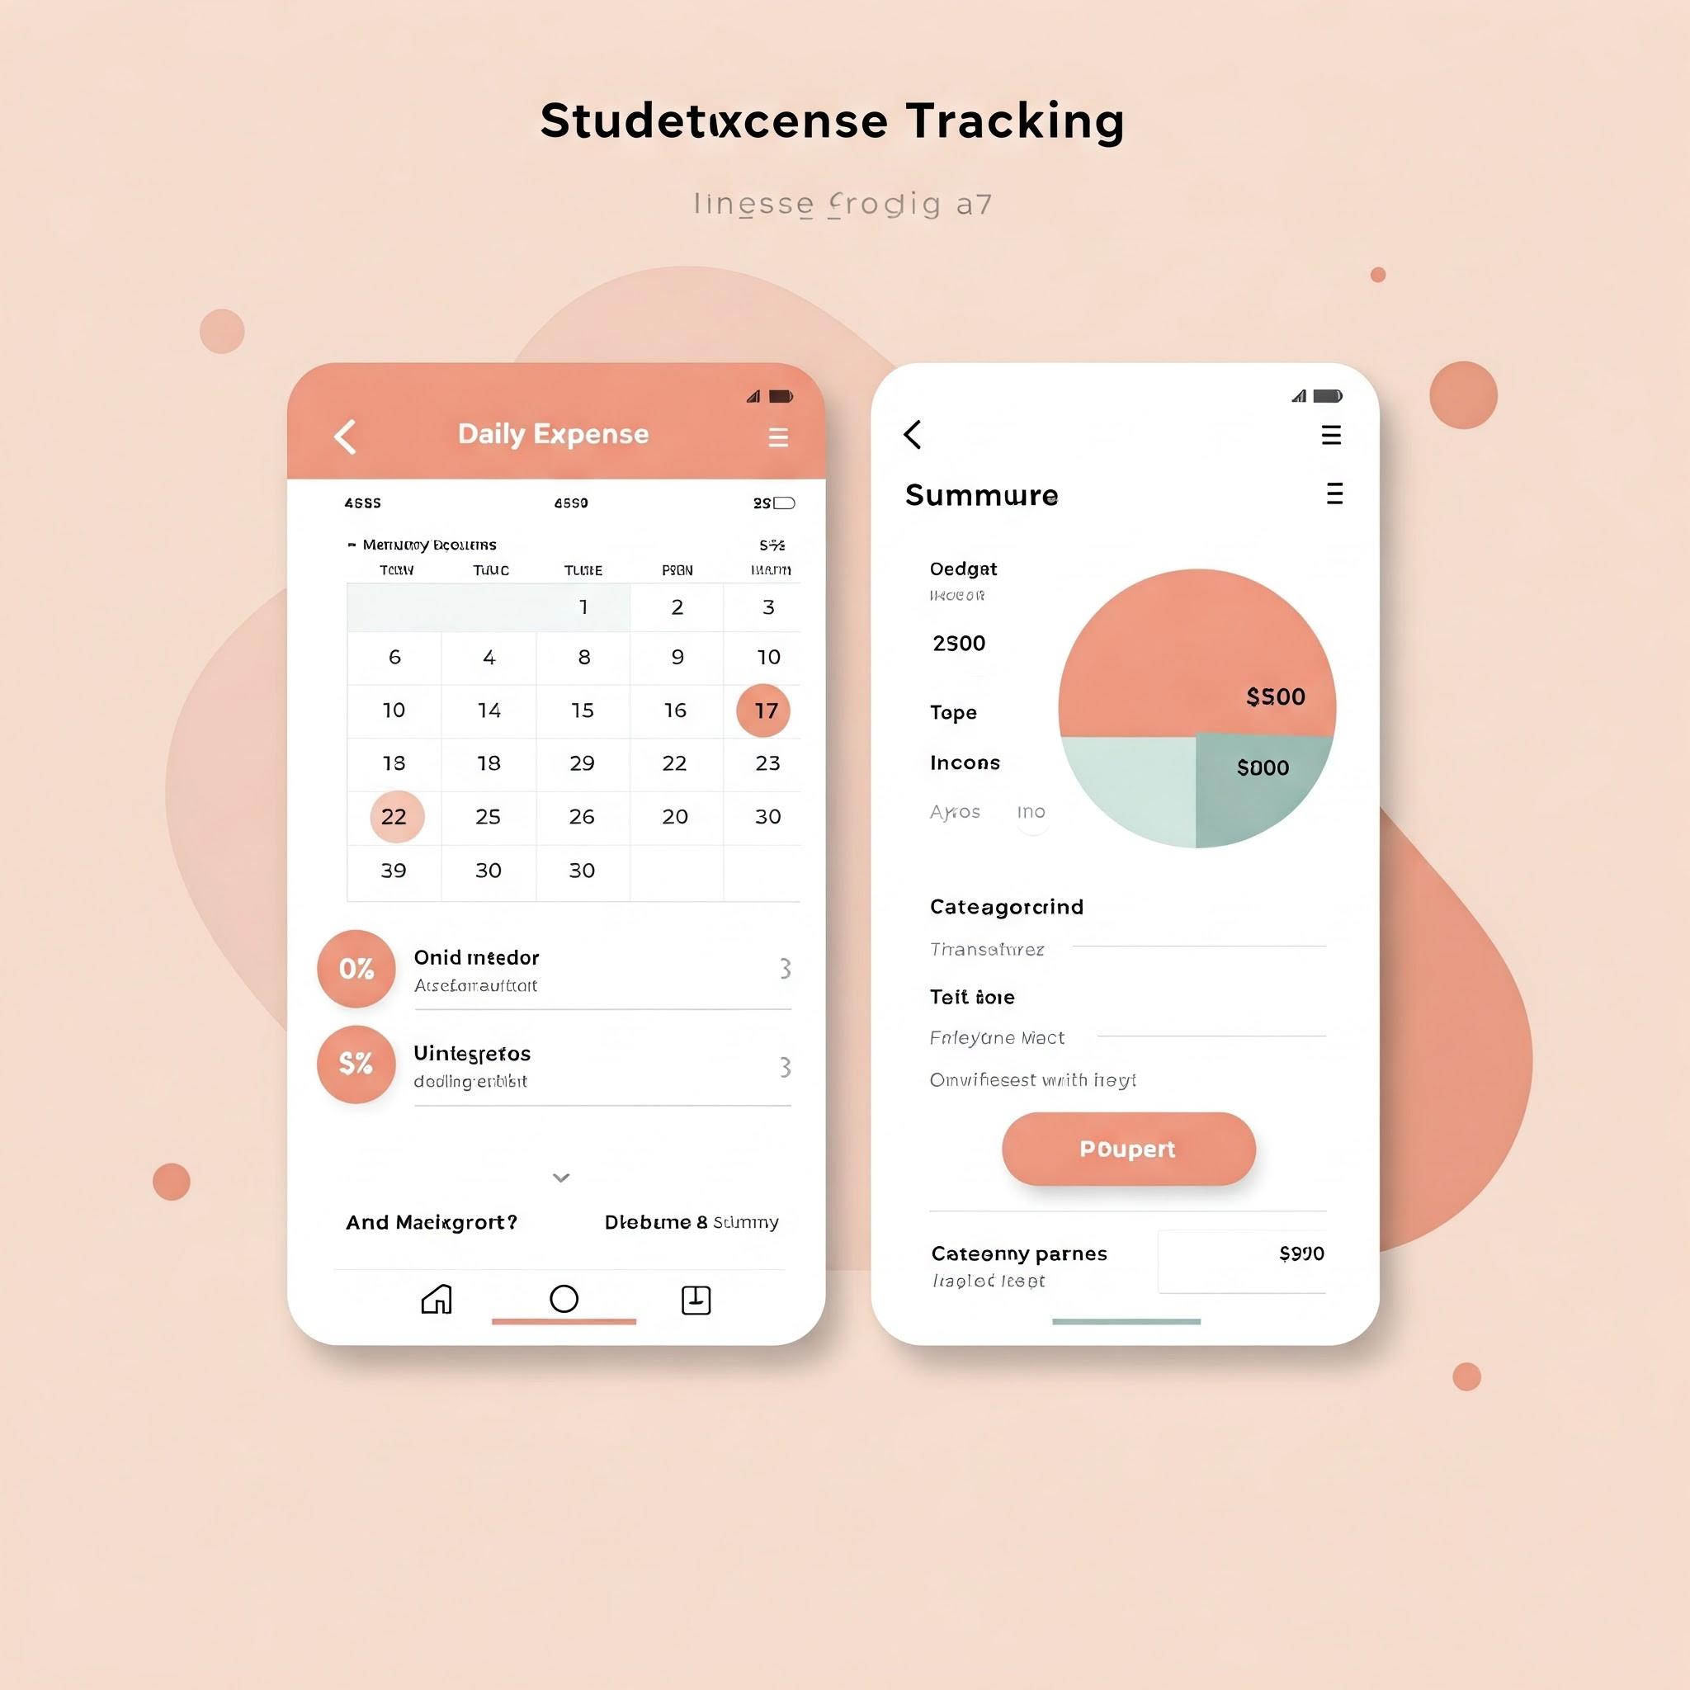



Key Features: Simplifying Financial Management
Expense Tracking
Budgeting Tools
Financial Insights
Enables users to set budgets and monitor progress, promoting responsible financial management.
Automatically tracks all expenses, providing a comprehensive overview of spending patterns.
Provides detailed analytics and visualizations to help users understand their spending habits and make informed decisions.
K.R. MANGALAM UNIVERSITY

Slide 7




Challenges and Considerations
Security and Privacy
1
Protecting user data and ensuring privacy is paramount.
Accessibility
2
The app needs to be accessible and usable for students with diverse backgrounds and learning styles.
Compatibility
3
Ensuring compatibility with multiple devices and platforms is crucial for widespread adoption.
User Engagement
4
Motivating users to consistently use the app is critical for achieving desired outcomes.
K.R. MANGALAM UNIVERSITY

Slide 8
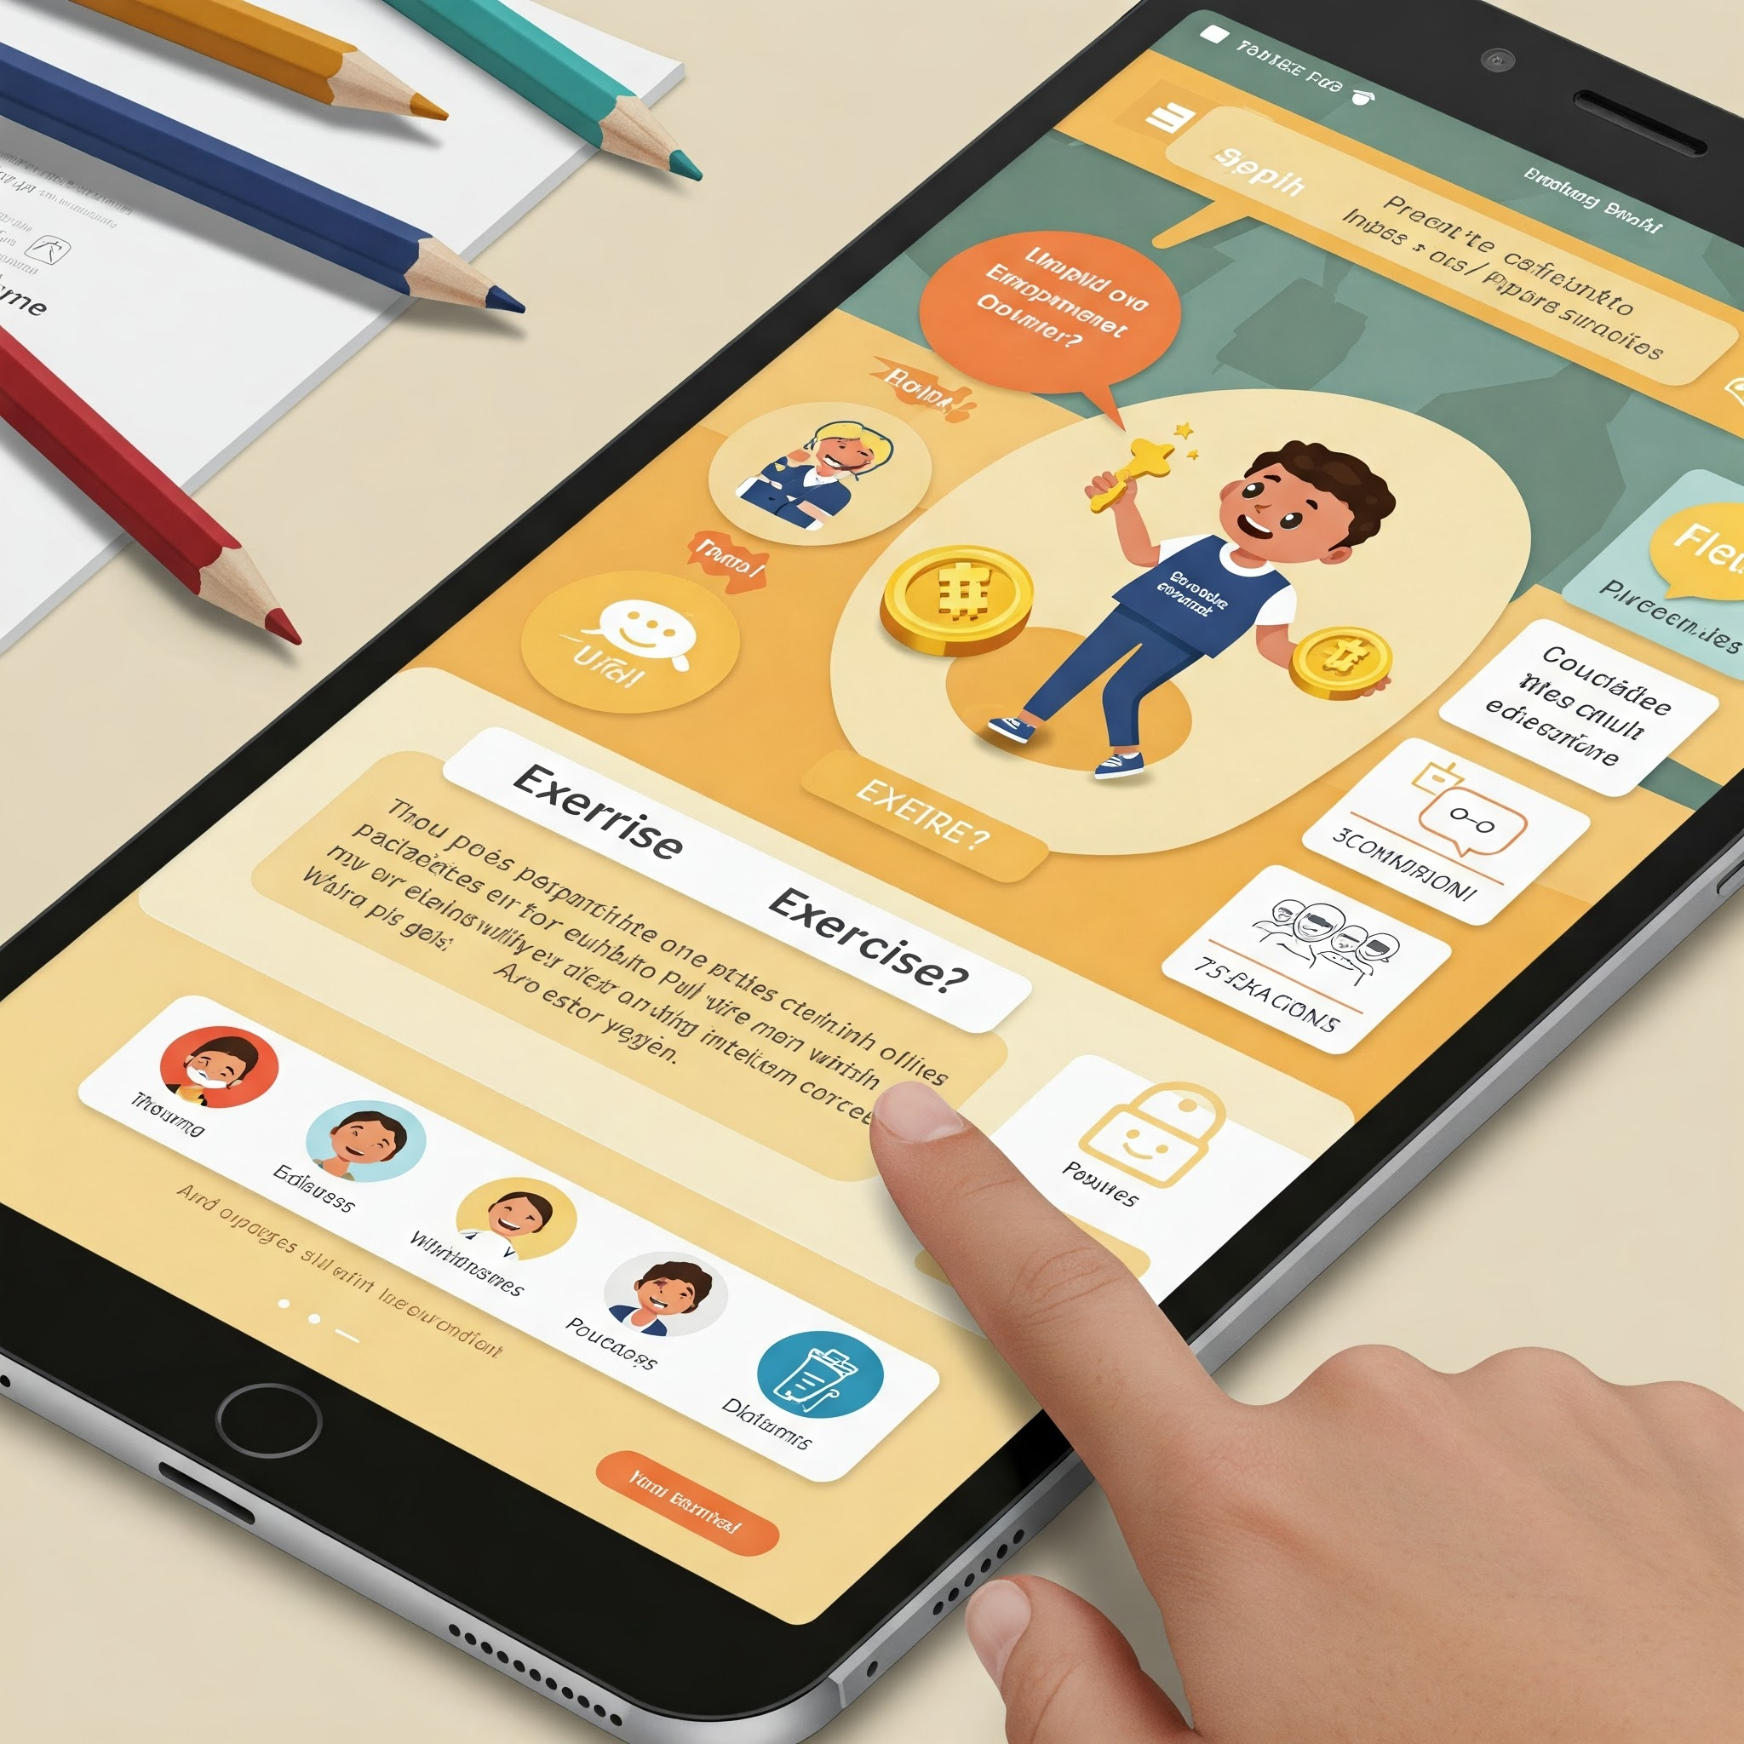
The Future: Empowering Students, Transforming Finances
this project is a game-changer in student financial management. Looking ahead, we plan to: Integrate AI-driven spending predictions to optimize financial planning. Expand payment tracking features (linking with bank accounts or UPI). Gamify financial learning to make budgeting fun and engaging.
Introduce community features where students can share financial tips and strategies.
K.R. MANGALAM UNIVERSITY

Slide 9

Take Control of Finances
Improved Savings
Save more money effectively.
Reduced Stress
Gain peace of mind about finances.
Smarter Spending
Make informed decisions easily.
K.R. MANGALAM UNIVERSITY

Slide 10

Key References
Research Papers
Reports
Websites
Search Google Scholar for studies on student financial management apps.
OECD & World Bank studies on digital finance and student budgeting.
Investopedia (personal finance guides), NerdWallet (budgeting tips).
K.R. MANGALAM UNIVERSITY

Slide 11
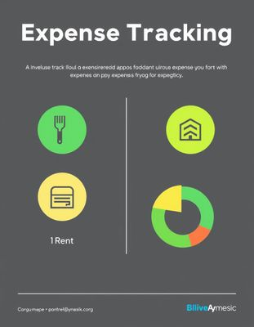
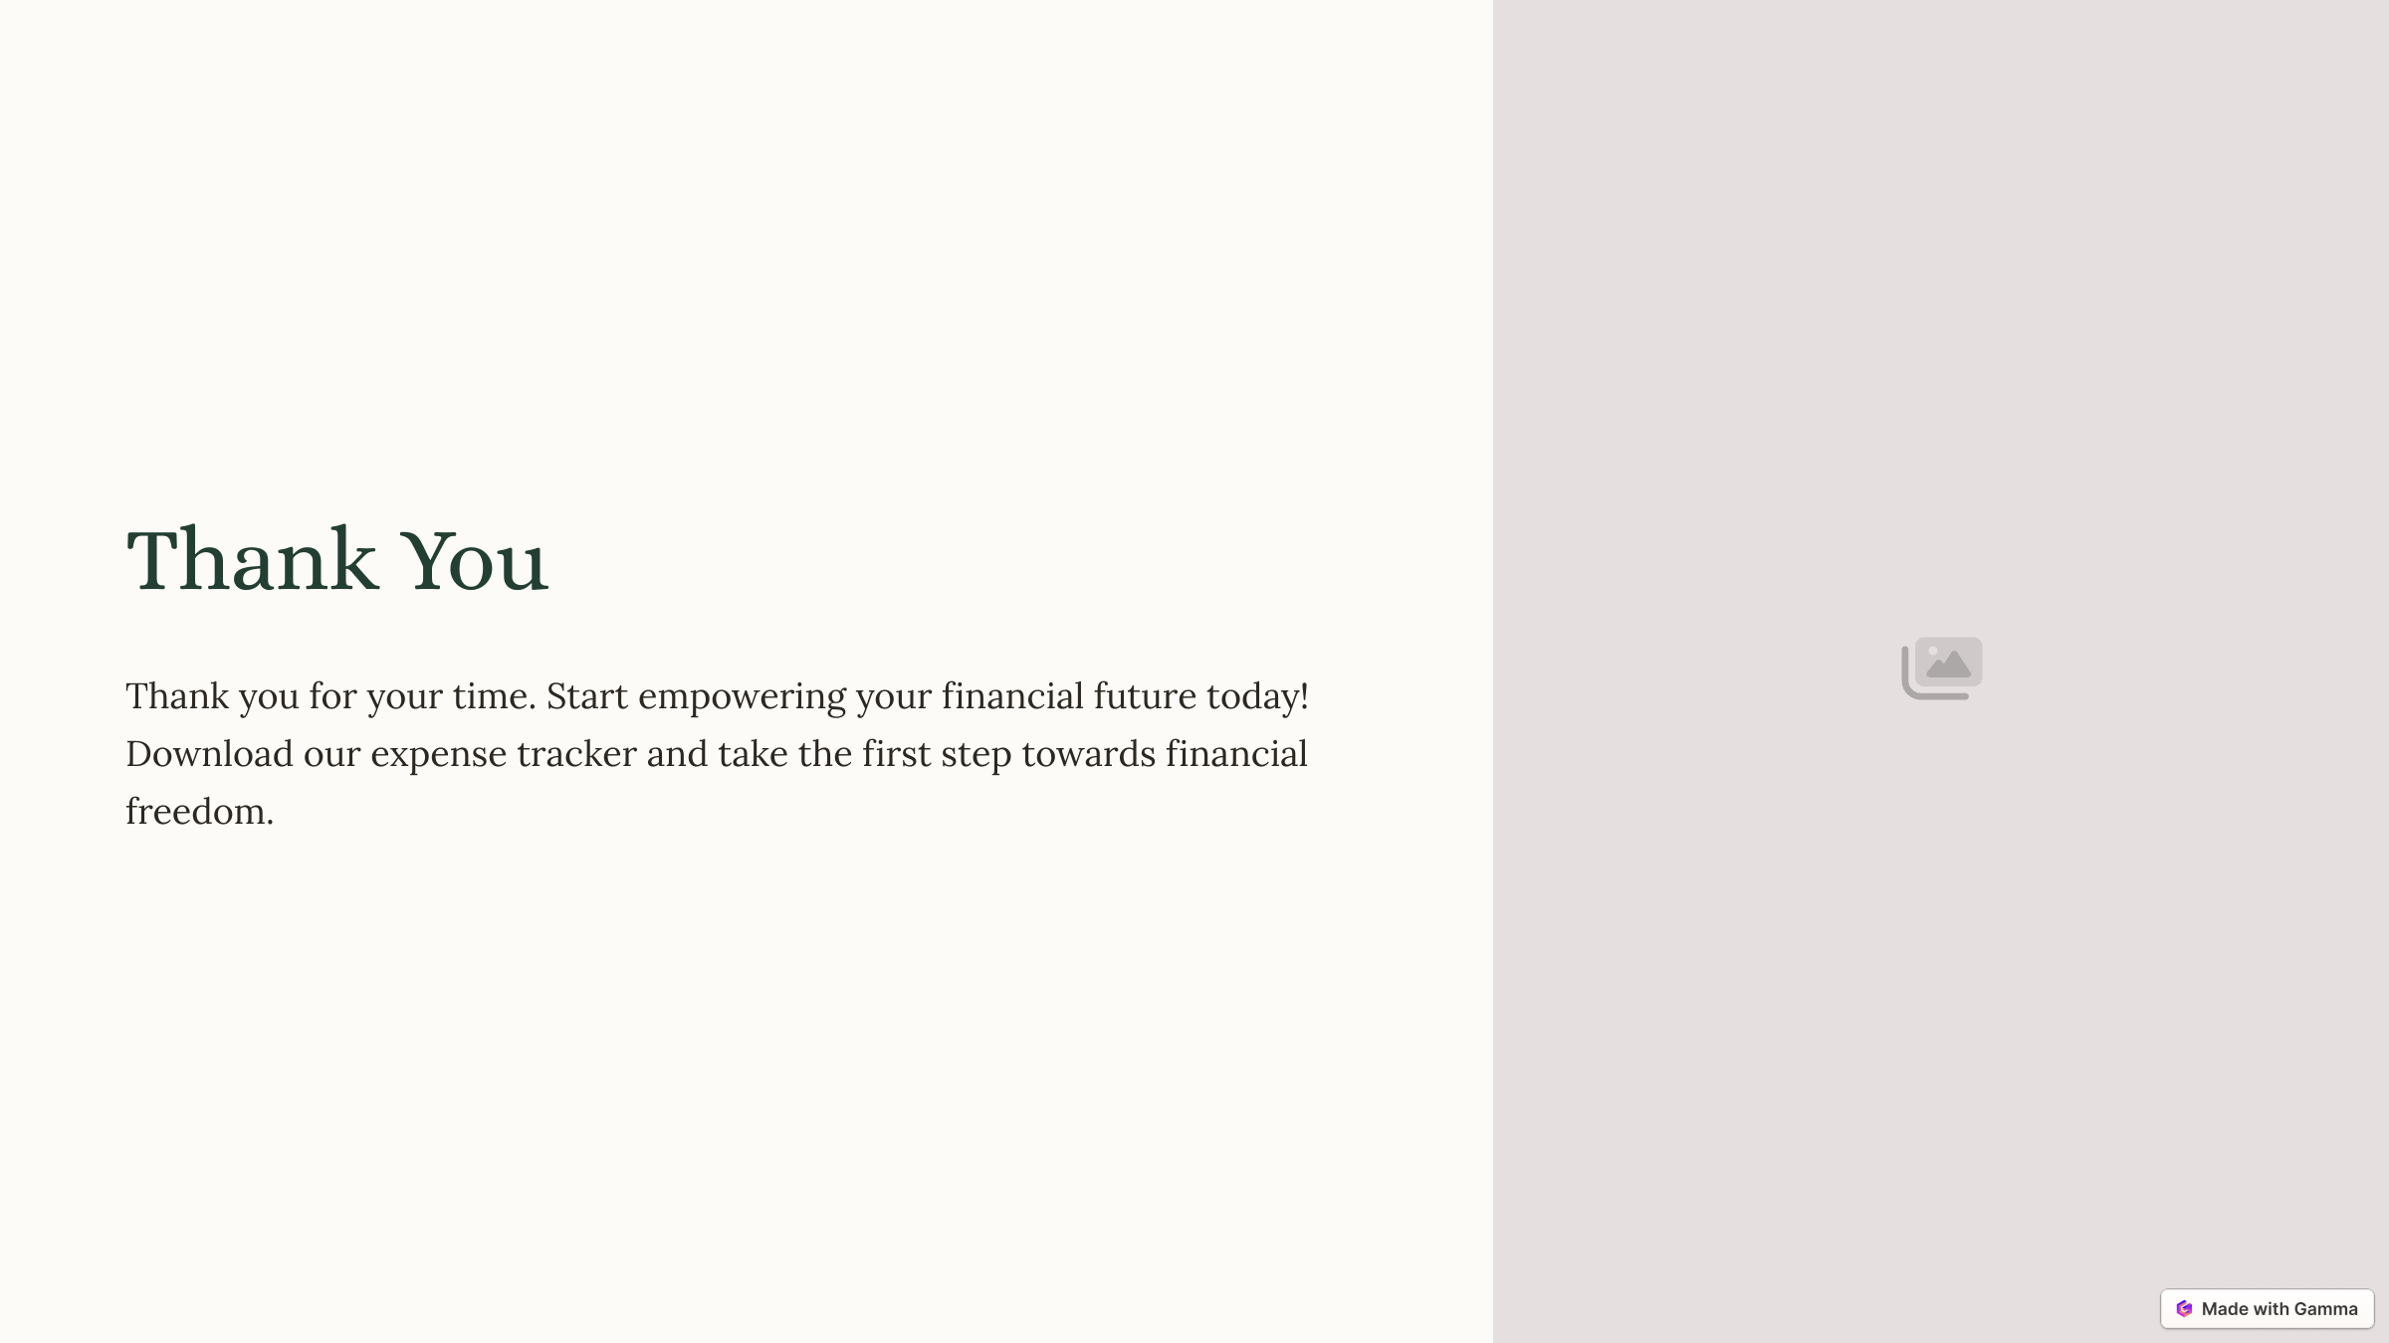
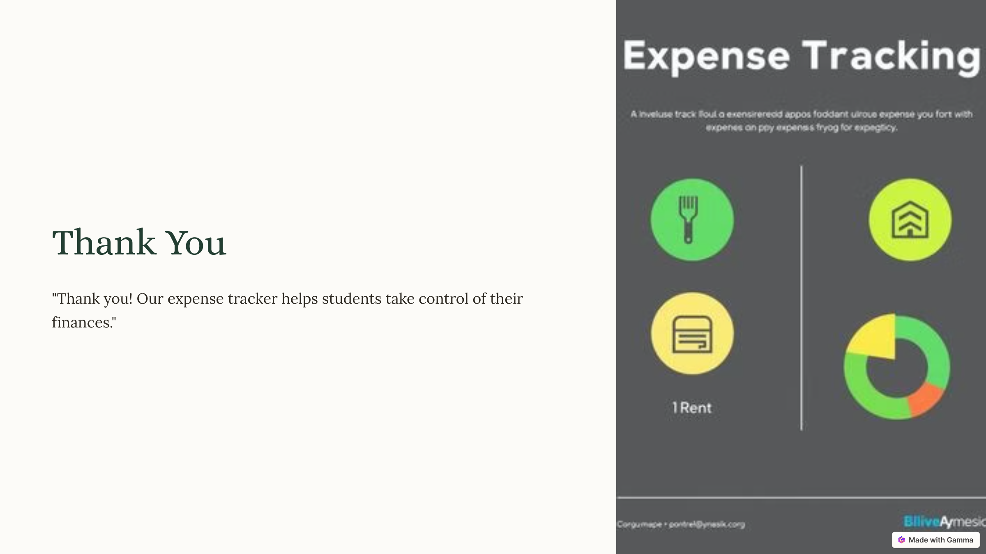
Thank You
K.R. MANGALAM UNIVERSITY
K.R. MANGALAM UNIVERSITY
K.R. MANGALAM UNIVERSITY

